Slide 1

BRAND GUIDE
Taylor Insurance Services
Consolidated Brand Strategy & Visual Identity // 2026
CONFIDENTIAL

Slide 2
WHY THIS GUIDE EXISTS
One Brand, Clearly Defined.
This guide consolidates the Taylor Insurance Services Brand Strategy and Brand Book into a single working reference — ready to drop into Claude or Gamma for any company project.
01
02
03
How We Look
What We Say
How We Make People Feel
Our refreshed visual identity — logo, color, typography, and photography.
Our positioning, brand truths, and the language that earns trust.
Our values, voice, and the Disruptor + Caring challenger stance.
Taylor Insurance Services // Brand Guide
Brand Foundations

Slide 3
BRAND TRUTHS
What We Stand For
We Actually
Care.
Our word is our bond. Plain dealing, integrity, and hard work — the principles that have defined TIS for nearly 60 years.
We care. We don’t just sell policies. We’re entrusted to protect businesses, employees, and communities as if they were our own.
“To me, this is a big part of our brand.” — Trey Taylor
Everyone says they care. The difference at TIS is that we actually do — and every part of the brand has to live up to that.
We work for employers, not carriers. We create innovative solutions that put the client’s needs and bottom line first.
Corporate competence, no red tape. Big-firm expertise and resources without the bureaucracy or runarounds.
Innovation is in our DNA. From the earliest days, TIS has created better ways to serve clients and community.
57 years in business · founded on plain dealing, integrity, and hard work.
Taylor Insurance Services // Brand Guide
Brand Foundations

Slide 4
BRAND POSITIONING // SECTION 1
Brand Architecture
Clear brand architecture ensures every audience sees the right message, from the right brand, at the right time — preventing confusion across Staff, the GA Channel, Affinity Partners, Prospects, and Customers.
Direct-to-Client & Affinity Sales
GA Broker Channel & GA Affinity Sales
Taylor Insurance Services
Leads
Spectrum Benefits
Stands Alone
TIS is the lead brand and the entity that sells and services the client. Spectrum Benefits appears as a featured offering — a clear differentiator that signals innovation.
Spectrum Benefits operates as an independent national brand. TIS remains invisible or secondary to avoid competitive conflict and let both brands stay in their lane.
Taylor Insurance Services // Brand Guide
Brand Architecture

Slide 5
BRAND NAMING
TIS · Spectrum Benefits · Spectrum Health
How each sub-brand fits within the broader Taylor Insurance Services ecosystem.
Taylor Insurance Services
Company Brand
A 57-year-old, locally owned brokerage known for innovation, integrity, and client service.
Spectrum Benefits
Program Brand
A branded benefits program developed by TIS; a flexible, cost-effective alternative to carriers, sold through TIS and third-party brokers.
Spectrum Health
Product Name
An ACA-compliant, level-funded health plan with four simple, pre-packaged plan designs.
Spectrum Advanced
Product Name
A bundled offering combining Spectrum Health with GAP coverage for enhanced financial protection.
Other Spectrum Offerings
Product Category
Voluntary benefits — dental, vision, life, and disability — available under the Spectrum Benefits umbrella.
Taylor Insurance Services // Brand Guide
Brand Naming

Slide 6
BRAND POSITIONING BY CHANNEL
Six Channels, Two Brands
How TIS and Spectrum Benefits present across every business-development and delivery channel.
01
02
03
TIS Direct Sales
Affinity Strategy for Direct Sales
New GA Channel Development
Lead: Taylor Insurance Services
Lead: Taylor Insurance Services
Lead: Spectrum Benefits
Spectrum Benefits is a clear differentiator; TIS sells and services the client.
Association + TIS co-brand outreach; TIS leverages association credibility.
TIS referenced as creator/back-end partner; Spectrum leads outward messaging.
04
05
06
GA Channel Sales
Affinity — GA Channel Owns Relationship
GA Channel’s Own Affinity Relationships
Lead: Spectrum Benefits
Lead: Spectrum Benefits
Lead: Spectrum Benefits
100% Spectrum-driven; TIS is not visible. The GA broker owns the relationship.
Spectrum bridges to the Association; GA broker owns the client. TIS invisible.
GA agent introduces Spectrum into an existing association relationship.
Taylor Insurance Services // Brand Guide
Channel Strategy

Slide 7
BRAND POSITIONING
Taylor Insurance Services — Voice & Stance
Disruptor Challenger
Caring Challenger
Bold, outspoken, and visionary — pushes against industry norms and refuses to settle for “the way it’s always been done.” Drives innovation and keeps TIS ahead of the curve.
Purpose-driven and empathetic — focused on doing what’s right for clients, employees, and the community. Builds trust through integrity, hard work, and care.
Brand Positioning
Brand Tone
A trusted local insurance brokerage with nearly 60 years of history.
Trusted and Well-Informed.
Rooted in hard work, integrity, and plain dealing — “Our word is our bond.”
Corporate-level competence without corporate red tape.
Capable, not stubborn. Dependable, not stale. TIS shows up bold and innovative — always grounded in care and community.
Bold enough to challenge industry norms, grounded enough to feel safe and stable.
Taylor Insurance Services // Brand Guide
Brand Positioning

Slide 8
TARGET CUSTOMERS // SECTION 2
Taylor Insurance Services — Our Ideal Client
Local small to mid-sized employers, and community-based organizations that value cost savings and personalized service.
10–50 employees
50–100 employees
100–250 employees
Secondary Target
Primary Target — Sweet Spot
Additional Target
Decision Makers
Decision Makers
Decision Makers
Office/Admin Manager, Operations Manager, Business Owner
HR Manager, Office Manager, Operations Manager, Business Owner/Partner
HR Manager, CFO/COO, Business Owner/Partner
Smaller, less-resourced employers; decisions concentrated in one or two roles. Cost-sensitive, prioritizing simplicity and ease of administration.
Wants to control healthcare costs while protecting employee benefits. Prioritizes “safe” and “no extra work.”
More structured HR and finance teams; CFO/COO focuses on budget impact, compliance, and long-term sustainability.
Taylor Insurance Services // Brand Guide
Target Customers

Slide 9
BRAND POSITIONING
Spectrum Benefits — Positioning & Stance
Brand Positioning
Challenger Type
A level-funded benefits solution that brings cost control to runaway healthcare premiums for small businesses, local governments, associations, and unions.
Innovator Challenger
Custom level-funded programs built by brokers, not carriers — cutting waste, focusing dollars where they matter.
Simplifies self-funded programs into four easy-to-sell packages — easy to buy, easy to run, easy to trust.
Next Gen Challenger
Makes level-funded plans once reserved for big employers accessible to small and mid-sized businesses.
An innovative yet safe, cost-effective alternative that exposes bloated, one-size-fits-all insurance for what it is.
Status Quo Challenger
Better plans, less admin — HR and the P&L are both happy.
Exposes bloated, one-size-fits-all insurance, proving a smarter, leaner way to control costs year over year.
Taylor Insurance Services // Brand Guide
Spectrum Benefits

Slide 10
TARGET CUSTOMERS
Spectrum Benefits — Our Ideal Client
Primary: Brokers & General Agencies (GA Channel) · Secondary: Small & Mid-Sized Employers (10–250 employees)
GA Channel & Local Agents
Financial Advisory Firms
National Networks & Franchises
Sell Spectrum as one of their products to small and mid-sized businesses. Value the four simple packages and the ability to compete against carrier products.
Bundle Spectrum into broader advisory offerings. Look for credibility and simplicity selling benefits alongside financial services.
Distribute Spectrum at scale through member networks. Value it as an independent branded program that stands alone without conflict.
What We’re Competing Against
Legacy carrier products that are bloated and built for the carrier’s benefit. Traditional self-funded programs, typically reserved for employers with 200+ lives, burden smaller businesses with compliance overhead they can’t manage — pushing HR buyers to default to costlier, “safe” fully-insured options.
Taylor Insurance Services // Brand Guide
Spectrum Benefits

Slide 11


VISUAL IDENTITY // SECTION 3
Logo System
Main Logo
Vertical Logo
Horizontal Logo
The primary mark. Use whenever possible across print, digital, and everyday applications.
An alternate version for tall or narrow spaces, where the main logo doesn’t fit the format.
Optimized for wide layouts — websites, headers, or signage — for maximum readability.
Taylor Insurance Services // Brand Guide
Logo System

Slide 12
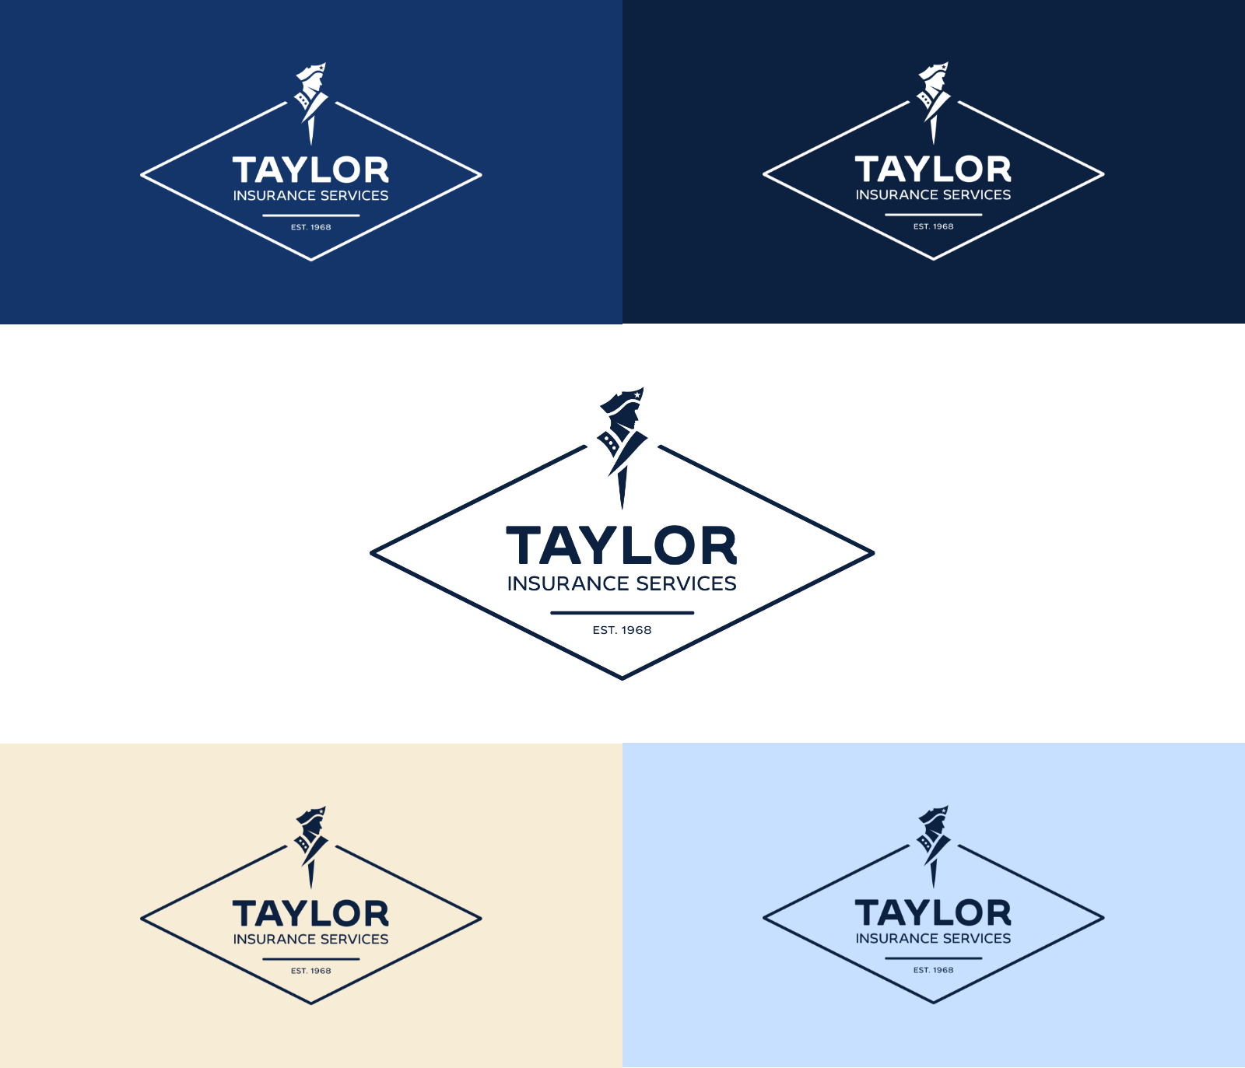
VISUAL IDENTITY
Logo Usage Rules
Approved Colors
Use the Taylor Black version whenever possible. When a dark logo isn’t an option — for example, on dark backgrounds — use the white version instead. This keeps the logo clear and recognizable in every setting.
Protection Zone
Always give the logo room to breathe. The clear space around it must stay free of text, graphics, or other design elements — keeping it legible and reinforcing its importance in every application.
Taylor Insurance Services // Brand Guide
Logo System

Slide 13
VISUAL IDENTITY
Brand Colors
Always lead with the primary colors. Use Pale Sky and Warm Parchment as welcoming backgrounds. Field Teal is a highlight / CTA color only — never a primary or background color.
Strong Blue
Taylor Black
White
#13356A
#0C203F
#FFFFFF
CMYK 82, 50, 0, 58
CMYK 81, 49, 0, 75
CMYK 0, 0, 0, 0
Primary
Primary
Primary
Pale Sky
Warm Parchment
Field Teal
#C8E0FF
#F7ECD6
#00BFA6
CMYK 22, 12, 0, 0
CMYK 0, 4, 13, 3
CMYK 100, 0, 13, 25
Secondary — Background
Secondary — Background
Highlight / CTA Only
Taylor Insurance Services // Brand Guide
Brand Colors

Slide 14
VISUAL IDENTITY
Typography
DESIGN FONT
HEADLINE FONT
BODY FONT
Byrd
Overpass
Open Sans
Taylor Insurance Services
Taylor Insurance Services
Taylor Insurance Services
ABCDEFGHIJKLM
abcdefghijklm
0123456789
ABCDEFGHIJKLM
abcdefghijklm
0123456789
ABCDEFGHIJKLM
abcdefghijklm
0123456789
A rounded, chunky, happy, slightly retro sans-serif. Used for key brand and design elements. Licensed for TIS in Regular and Bold.
Clean and modern — open, versatile, and highly legible. Used for online and digital headlines where Byrd can’t be used.
Neutral yet friendly, with clean lines for comfortable reading at small sizes. Used for all online and offline body copy.
Taylor Insurance Services // Brand Guide
Typography

Slide 15




VISUAL IDENTITY // SECTION 4
Photography
“We care” isn’t a tagline — it’s embedded in the brand, and photography is one way we signal it. Images should feel real, warm, and authentic: real people in real environments, not stock models in staged settings.
Who We Show: Clients, employees & families, community, and our own team.
Look & Feel: Warm and bright, natural light, genuine expressions, lived-in settings. Avoid staged, overly corporate, or impersonal images.
Keyhole Effect: The diamond shape from the logo is used as a photo mask for feature images and covers — a window into real moments that ties visuals back to the brand. Use for key visuals, not every photo.
Taylor Insurance Services // Brand Guide
Photography

Slide 16
NEW TOOLS // SECTION 5
Branded Sales & Marketing Tools
Equipping the TIS sales team and the Spectrum Benefits GA Channel.
Taylor Insurance Services
Spectrum Benefits
Reskinned website & direct sales collateral
Updated employer-facing website
TIS-branded sales flyer & leave-behind
GA Channel recruitment landing page & onboarding package
TIS × Spectrum cross-branded explainer video
GA sales collateral — explainer video, flyer, proposals
“Us vs. them” feature/benefit comparison charts
Anonymized case studies / renewal visuals
HR-focused intro pitch deck & branded quote document
“Always-on” GA outreach system
Leadership-focused closing pitch deck
National branding & search visibility (branded PPC)
Client success team & onboarding how-tos
Pre-renewal communications & renewal presentations
Taylor Insurance Services // Brand Guide
Brand Tools Roadmap

Slide 17
One Brand. Every Channel. Every Touchpoint.
Use this guide alongside the full Brand Strategy and Brand Book for complete detail — channel flowcharts, website samples, and brand application examples.
CONFIDENTIAL

